Slide 1
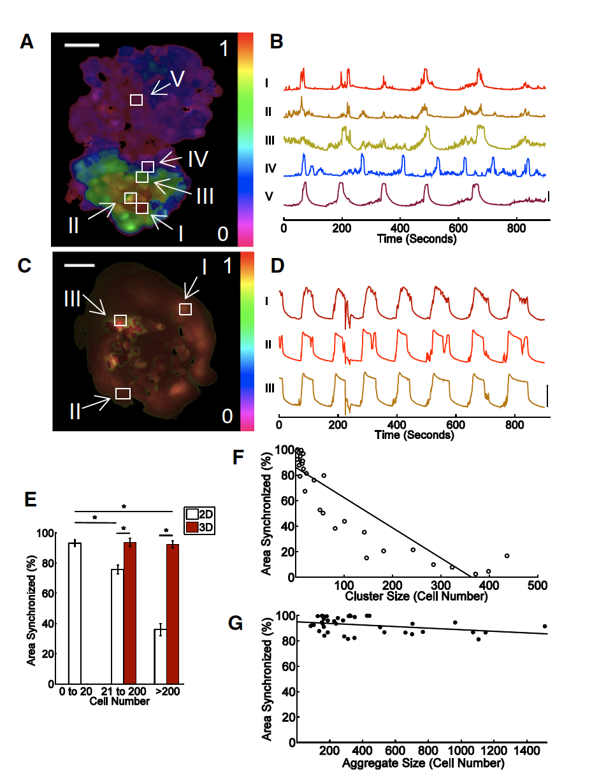
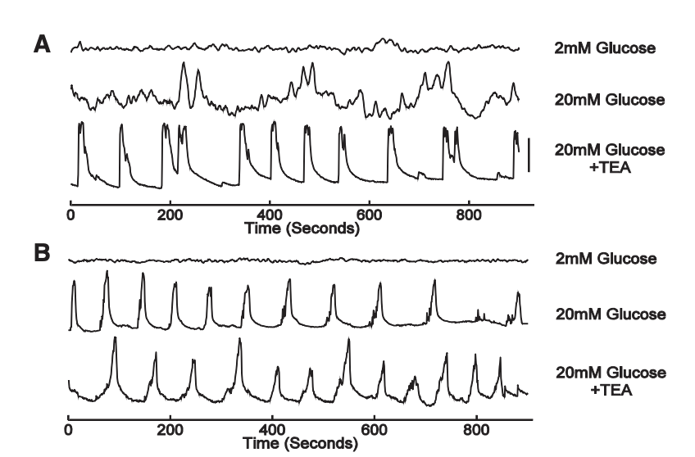
Dimension and size dependence of [Ca2+] synchronization
2D: ~4000 cells/mm^2 (MIN6)
3D: ~520,000 cells/cm^2 in hydrogel microwell arrays
[Ca2+] readout using Fluor4
50um
2D
3D
High-glucose + TEA
~5 cell synchronization radius in 2D
Synchronization is scale-dependent
in 2D but not in 3D
Dimensionality and size scaling of coordinated Ca2+ dynamics in MIN6 beta-cell clusters. Biophysical Journal. 2014
Notes:
1

Slide 2
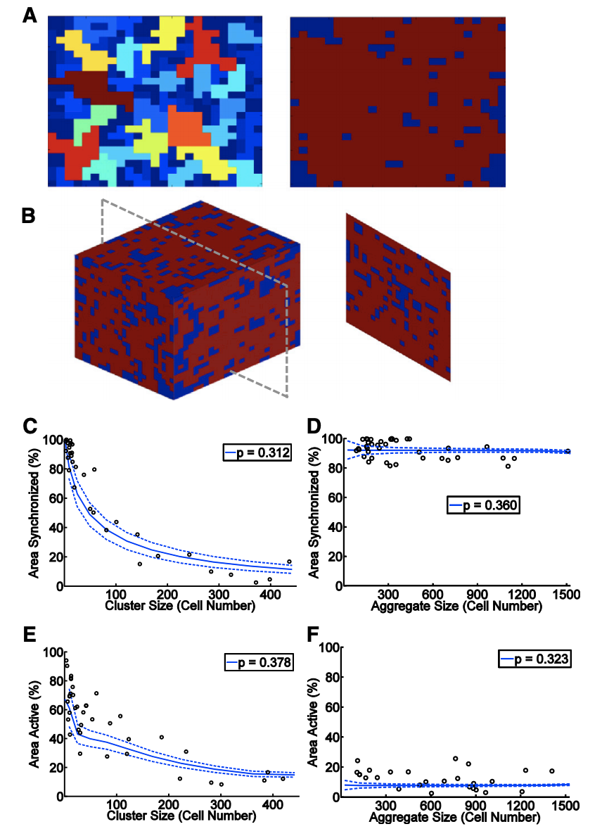
Coupled-resistor network model
p<0.5
p>0.5
2D
3D
Synchronization (high glucose)
2D
Suppression
(low glucose)
3D
Dimensionality and size scaling of coordinated Ca2+ dynamics in MIN6 beta-cell clusters. Biophysical Journal. 2014

Slide 3
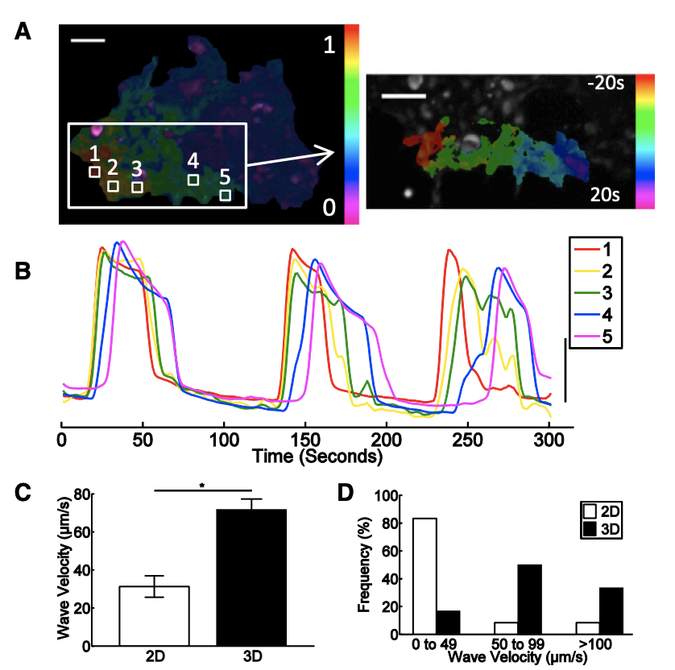
Wave velocity under 2D/3D coupling
2D
P<0.001
Dimensionality and size scaling of coordinated Ca2+ dynamics in MIN6 beta-cell clusters. Biophysical Journal. 2014

Slide 4
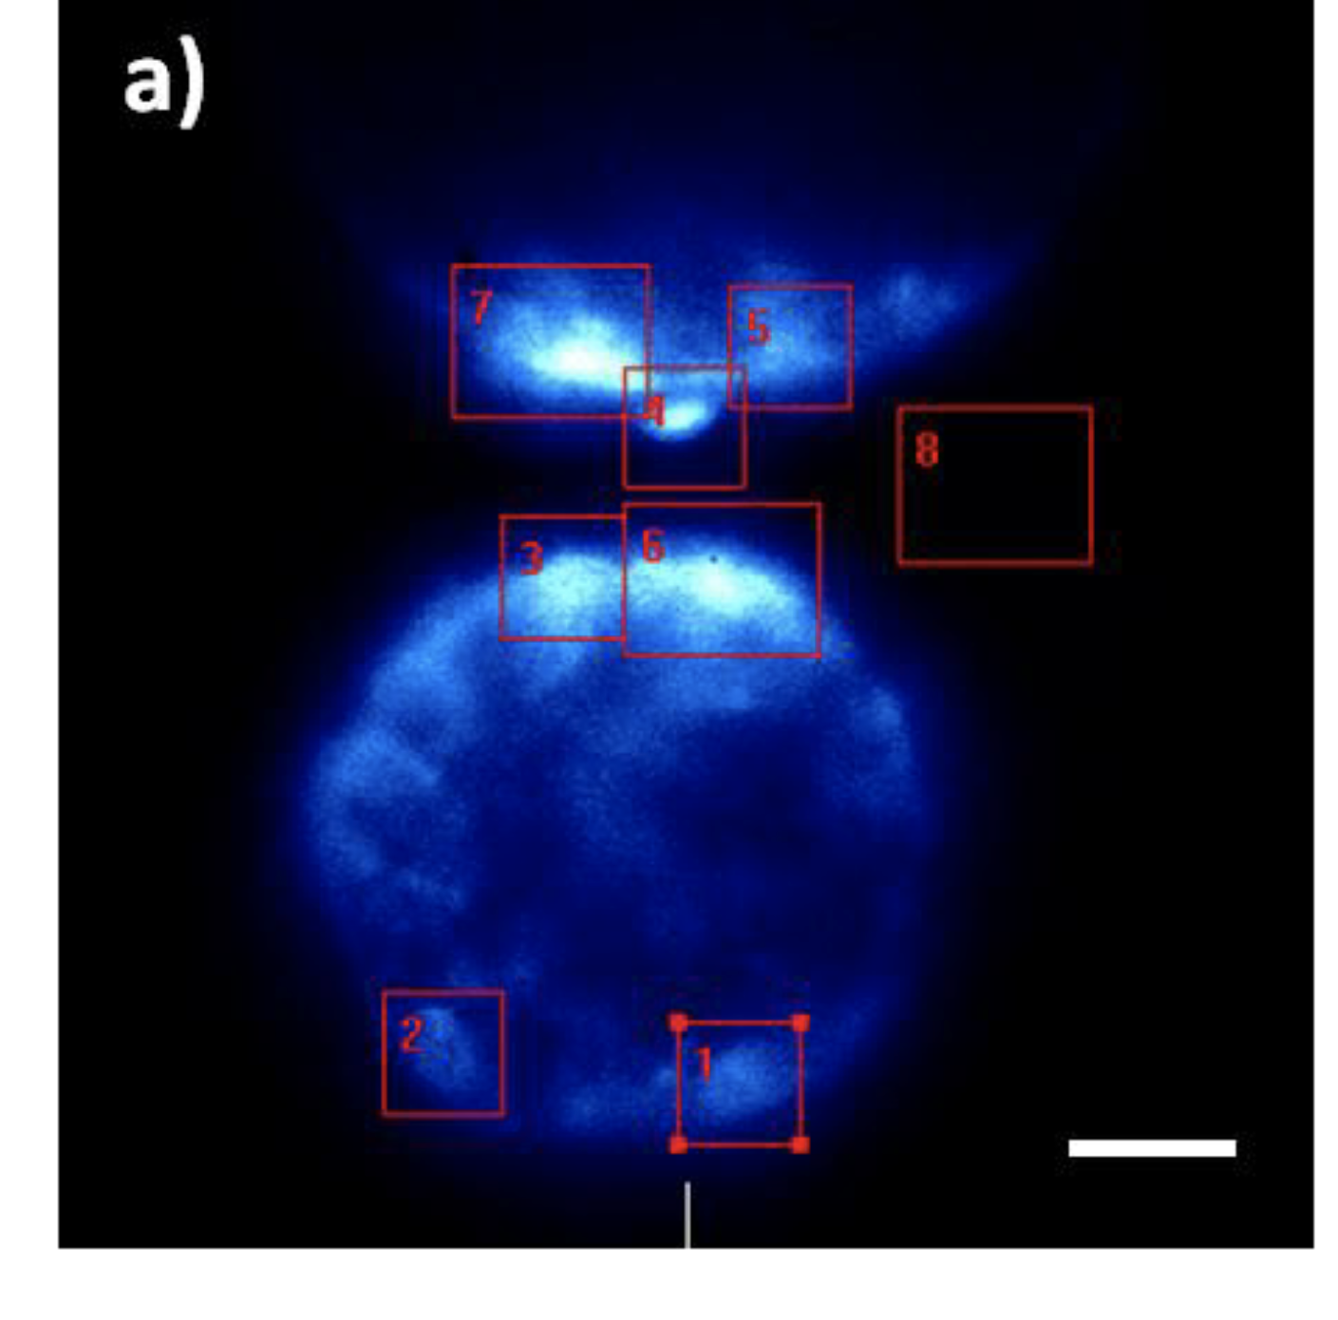
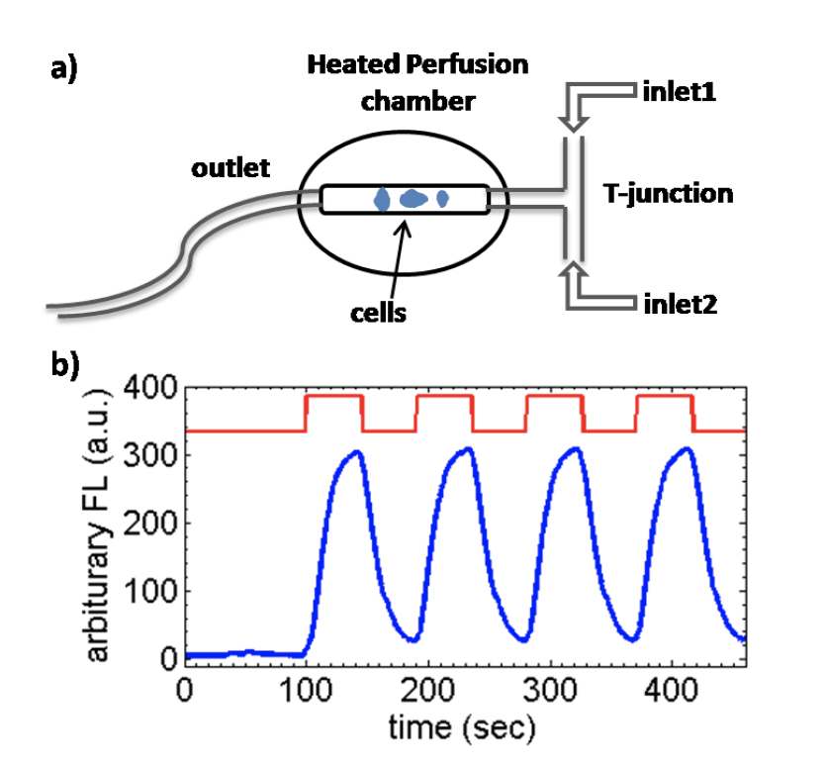
Interesting points
Low-pass frequency response of beta cells
Only small populations of cells (pacemakers) sense glucose stimulus
Unknown degree of randomness and strength of coupling
Entrainment of cells to glucose stimulus
Quantifying granule transport and controlling calcium oscillations in insulin-secreting beta cells. 2010

Slide 5
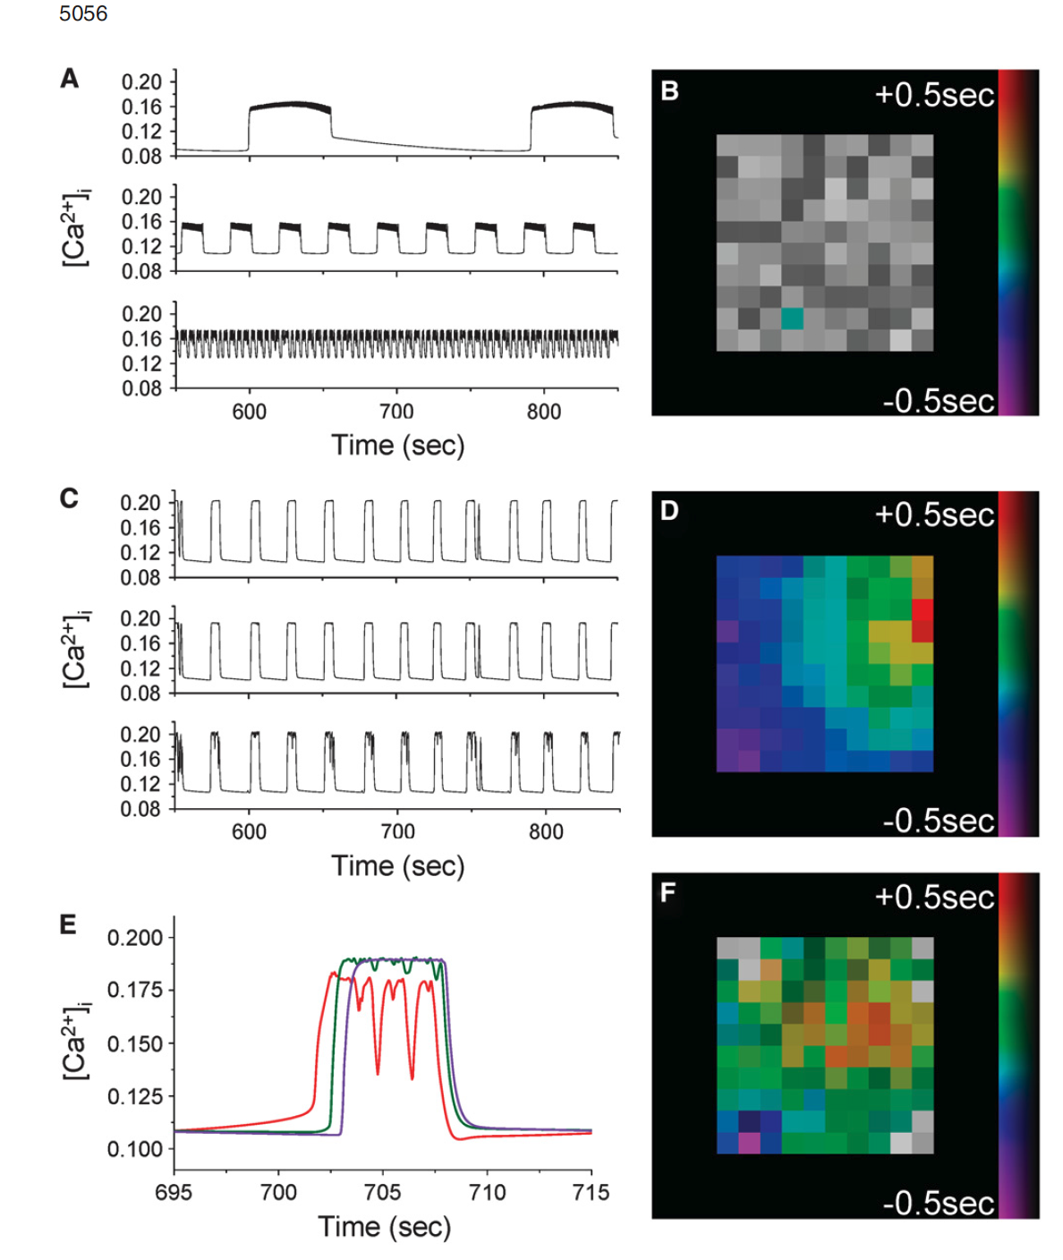
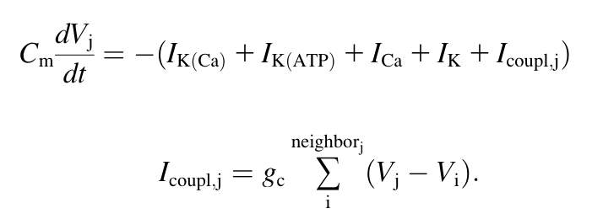
Coupled phantom burster model
How is this distributed?
Gap junction coupling and calcium waves in the pancreatic islet. Biophysical Journal
Notes:
5

Slide 6
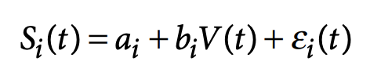
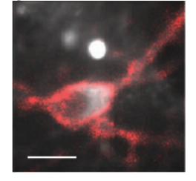
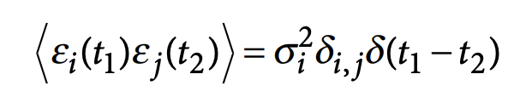
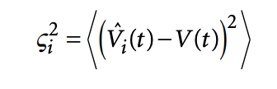
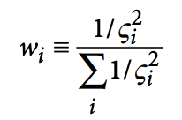
Estimating membrane potentials
Optical recording of action potentials in mammalian neurons using a microbial rhodopsin. Nature Methods
Notes:
Sensitive to background subtraction
No information about SNR
No information about photostability
Usually requires a user defined ROI
6

Slide 7
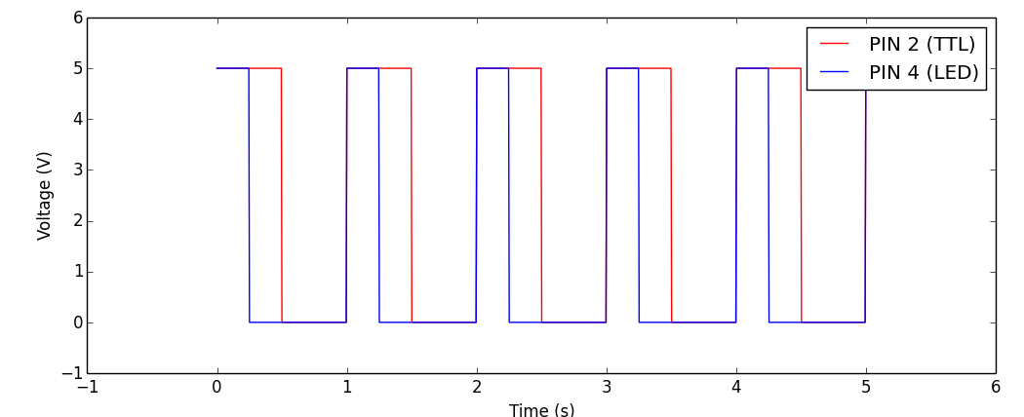
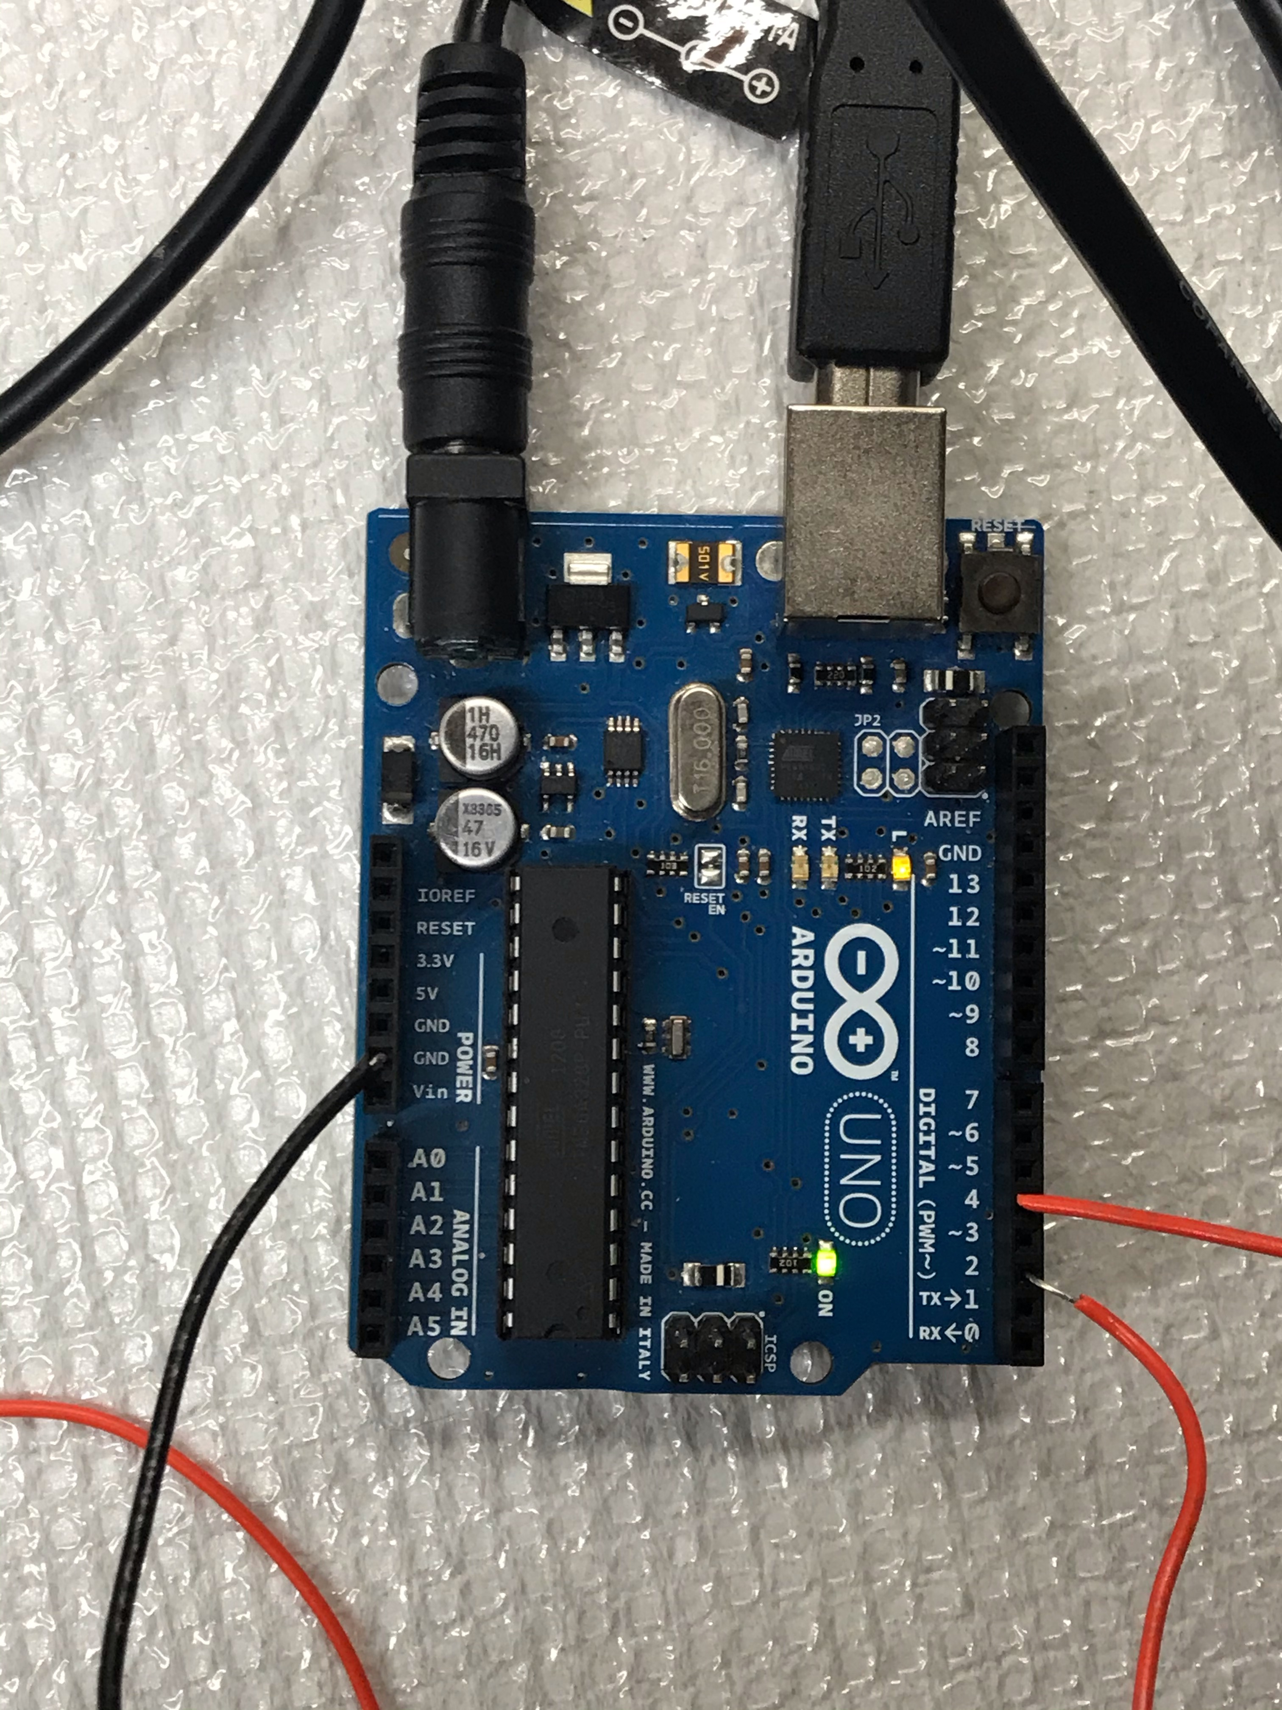

Analog Input
Onboard 10-bit ADC (6 channels)
16 MHz Arduino has ADC clock set to 16 MHz/128 = 125 kHz. Each conversion in AVR takes 13 ADC clocks so 125 kHz/13 ~ 10 kHz
Digital Input
12 digital I/O pins. No analog to digital conversion but input has to be 0 or 5V

Slide 8
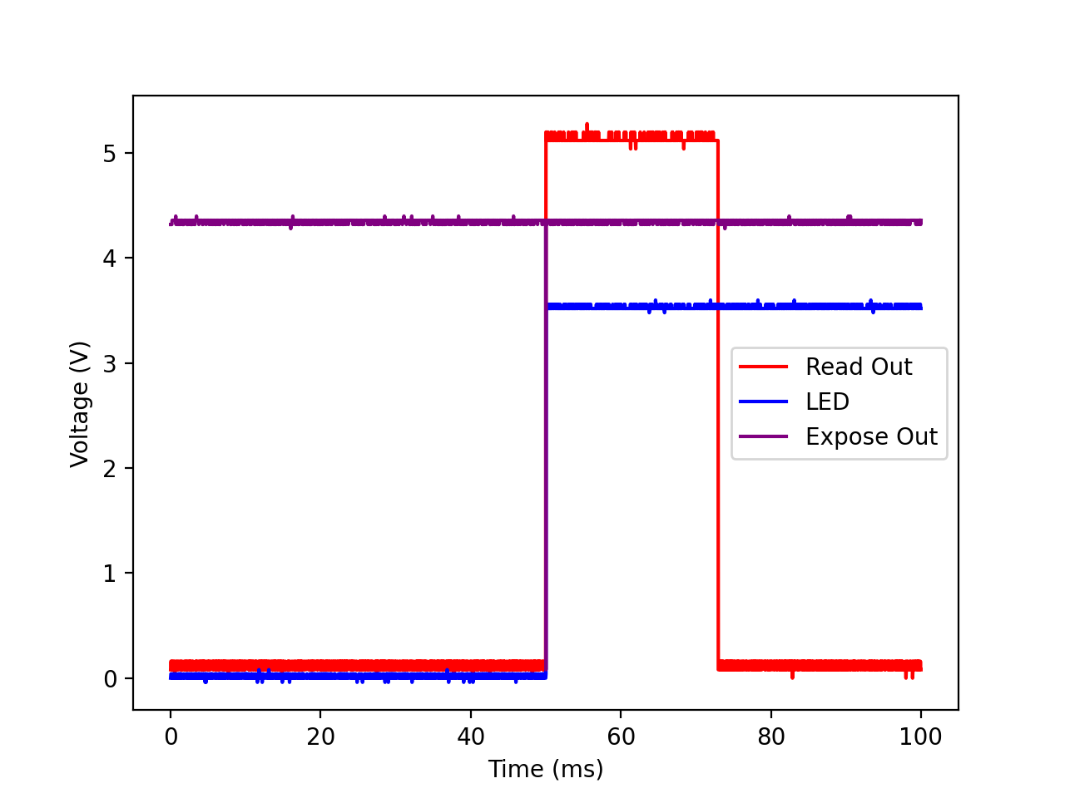
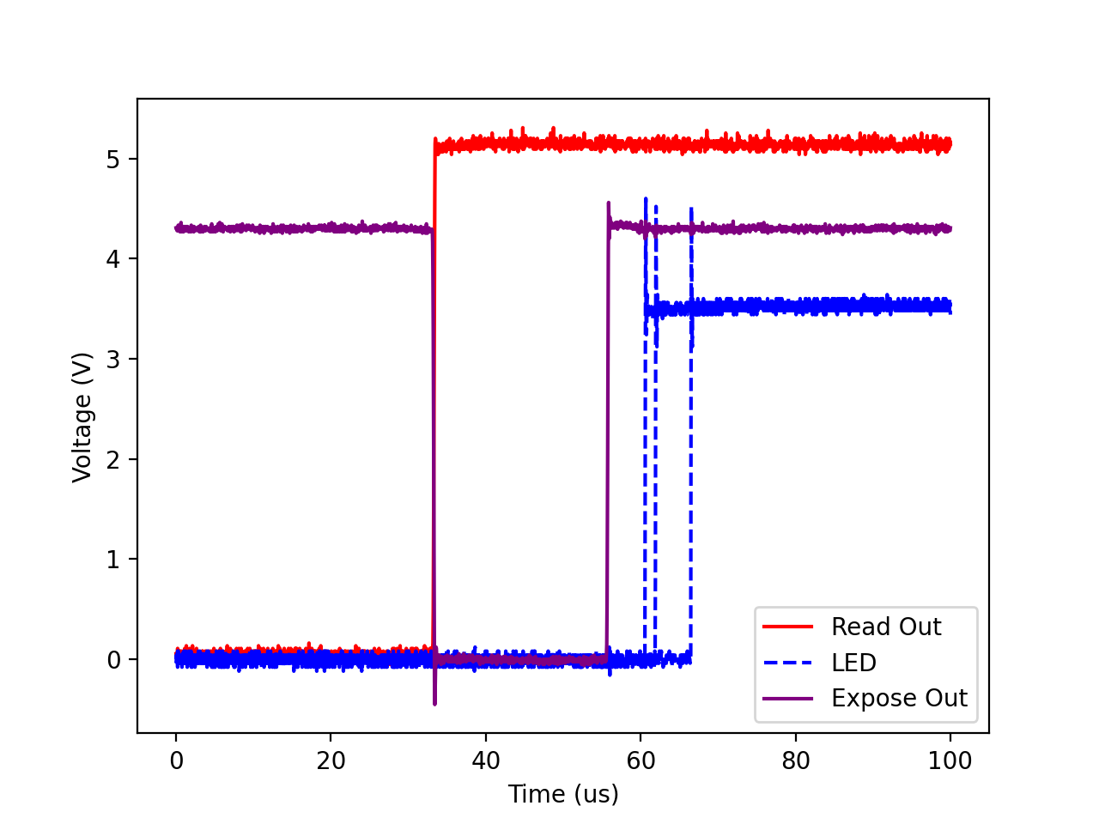
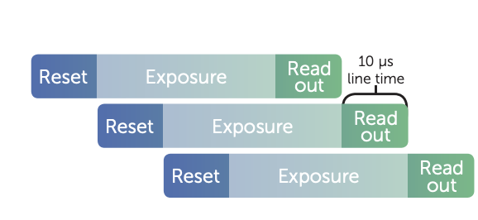
1s exposure
Expose-Out signal is high for each row the reset signal propagates past – any row that is exposing
Read-Out signal is high when any row is digitizing (?)
Notes:
We couldn’t find the global shutter setting
Aren’t we then collecting light from the next frame during the readout phase?
8

Slide 9
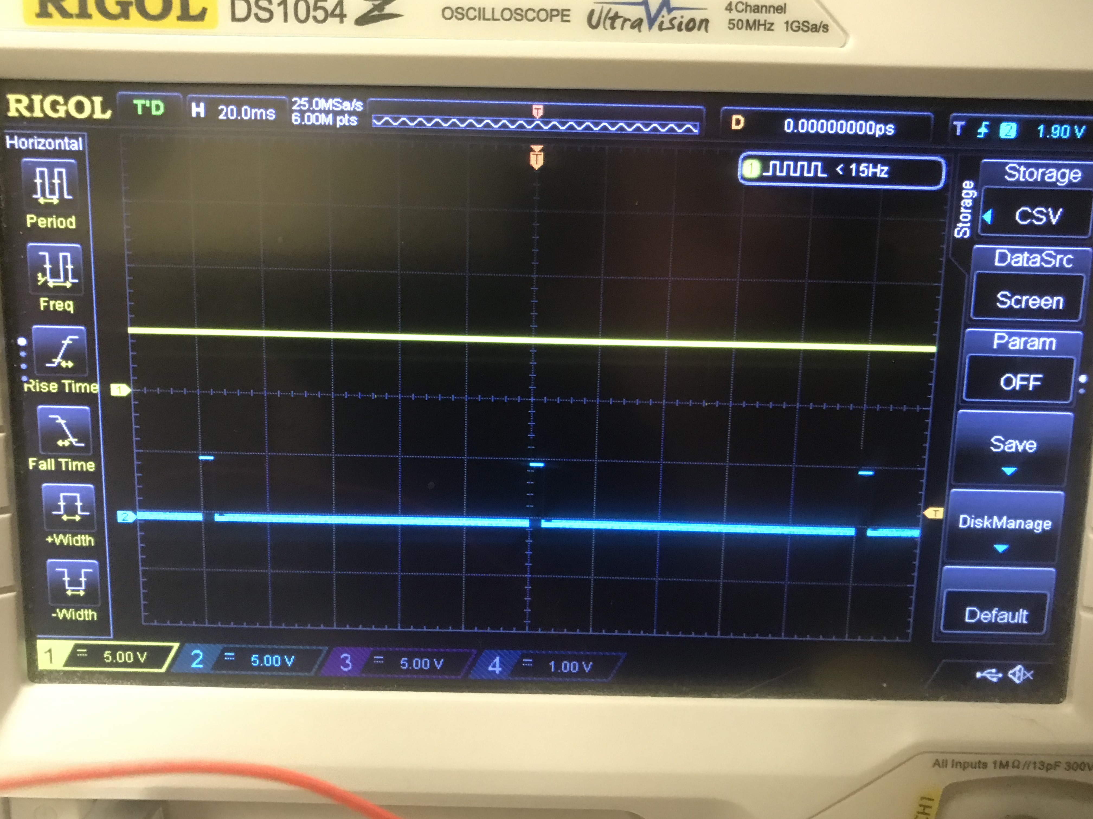
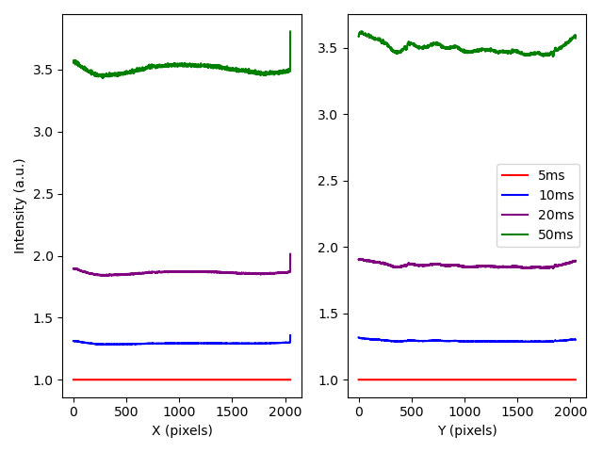
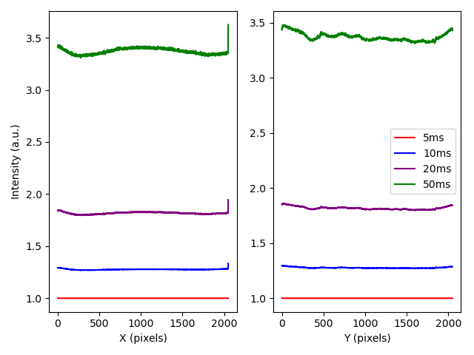
1s exposure
Immediate Pulse
Centered Pulse
5ms
5ms
Notes:
9

Slide 10
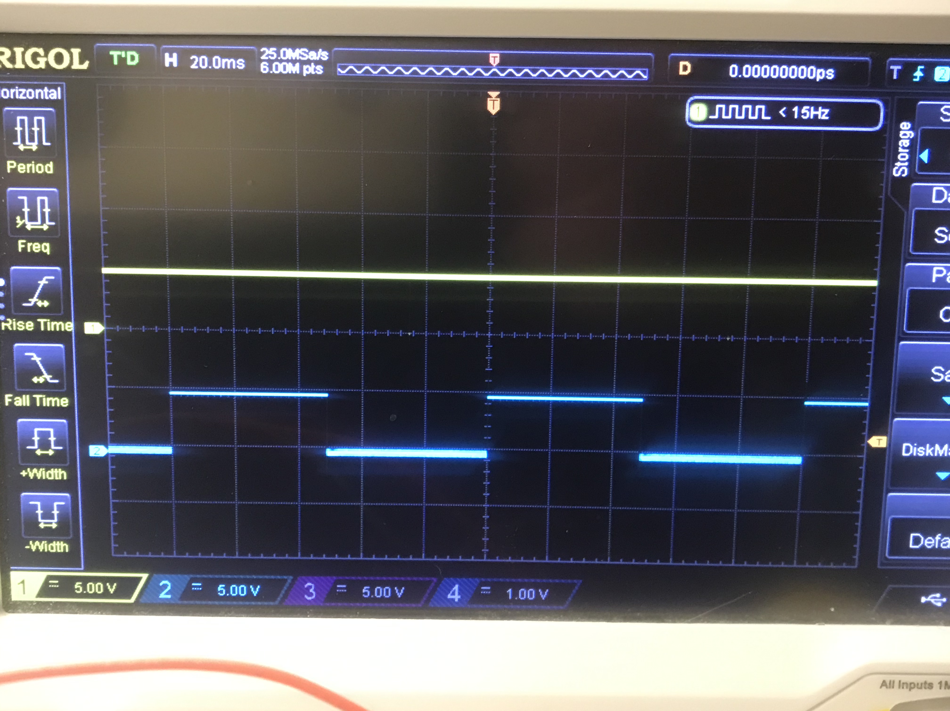
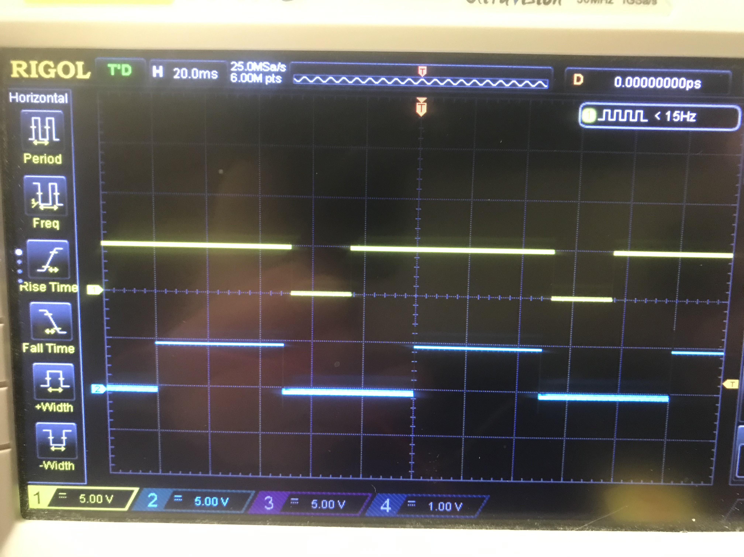
Different Expose Out Modes
Any Row
Rolling Shutter
High when any row is exposing
High when all rows are exposing and low during readout

Slide 11
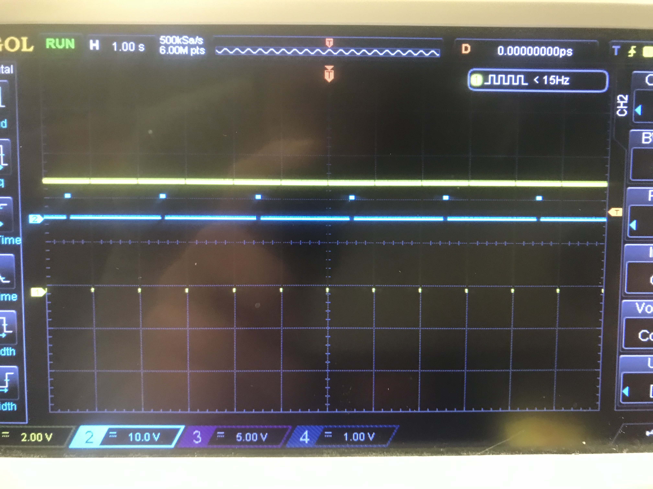
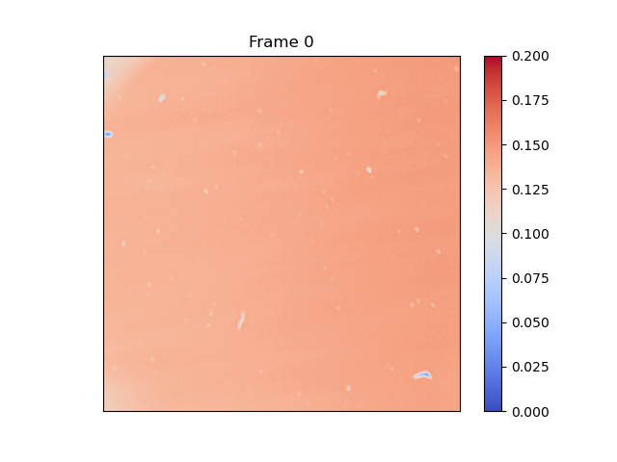
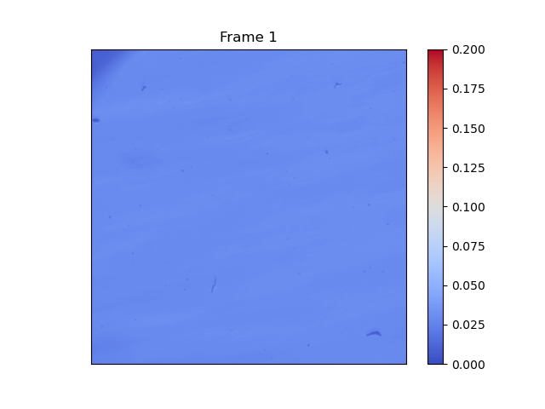
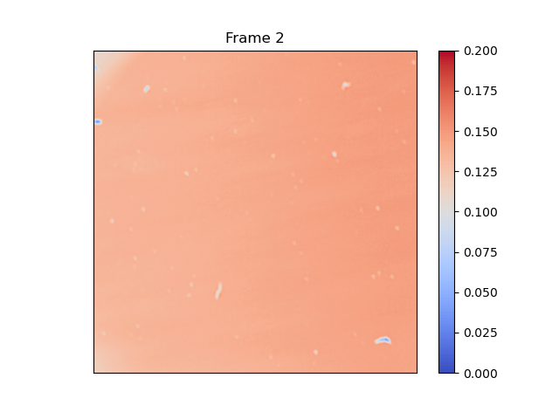
Pulsing Every Other Frame
100ms centered pulse 0.5Hz

Slide 12
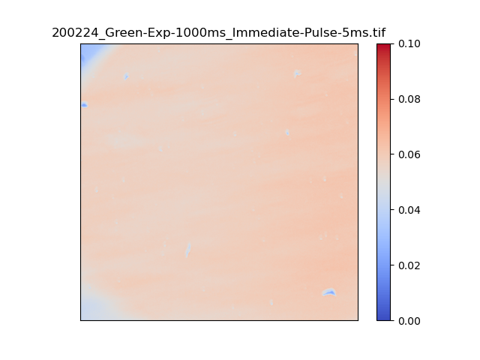
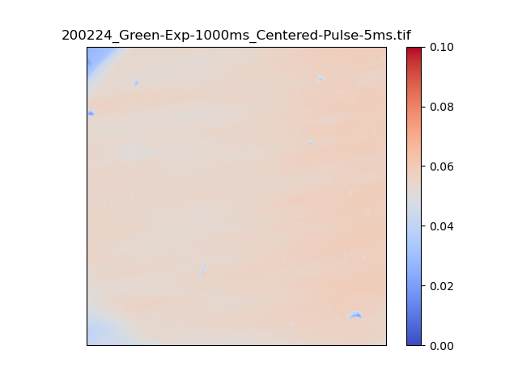
1s exposure
Immediate Pulse
Centered Pulse
5ms
5ms
Frame 5/20
Frame 5/20
Notes:
12

Slide 13
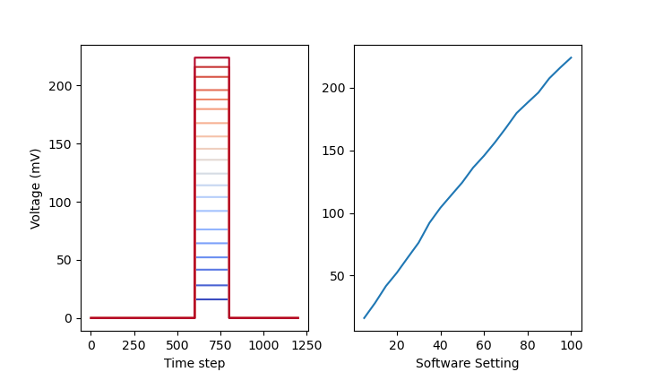
LED Calibration Curve

